Slide 1

Creating WhatsApp Chat bot
“Mymate”

Slide 2
Chatbots have become very popular. Almost all the business portals now have chatbots to serve the customer and quickly answer customer’s queries. These work round the clock to promote your business. In this blog, we will be discussing chatbot programming that will help in creating WhatsApp chatbot.
What is A WhatsApp Bot?
Before going ahead, you need to know about WhatsApp bot. It's a software program which we used on WhatsApp. It enables you to have a conversation with customers and handle their issues with the use of this platform. Moreover, chatbots programming work round the clock, and they instantly answer the customer’s query, thus enhancing the customer’s experience. Besides, you can save a lot of your time which you can use to focus on other customers.

Slide 3
Objectives of building WhatsApp bot
The objective of any business is to assist their customers and to resolve their queries. There are many ways in which companies are addressing customer queries. It’s a great way to increase customer engagement, and at the same time, it also helps in promoting a better response rate. The objective is to build the customer’s interest. Creating your chatbot will help you leverage the opportunity and work towards brand building. You can also personalize your experience with the customer. Besides, WhatsApp encryption ensures that the app is absolutely safe and secure.

Slide 4
Advantages of using WhatsApp bot
Sending reminders, alerts, and notifications.
Responding to customer's complaints and queries in real-time.
Helping customers to explore product catalog.
Sending updates on the ticket status and resolution.
Gathering customer feedback and more.

Slide 5
Frameworks used to build our chat bot?
We are mainly using Java Script for creating our chatbot.
WhatsApp using the Twilio API for WhatsApp.
We used MongoDB and Express js for backend.
ngrok : We will use this handy utility to connect the application running on your system to a public URL that Twilio can connect to. This is necessary for the development version of the chatbot because computer is likely behind a router or firewall, so it isn’t directly reachable on the Internet.

Slide 6
Features
Assignment alerts:
Deadline of college assignments.
It will give daily reminders for left submission.
Command : set assignment_<subject_name> <remind_time> <last_date>
Sample command : set assignment_Maths 1200 06/06
Output :
OK, will remind about assignment_Maths (Just after set query)
Here’s your reminder for assignment_Maths (At 12PM everyday)

Slide 7

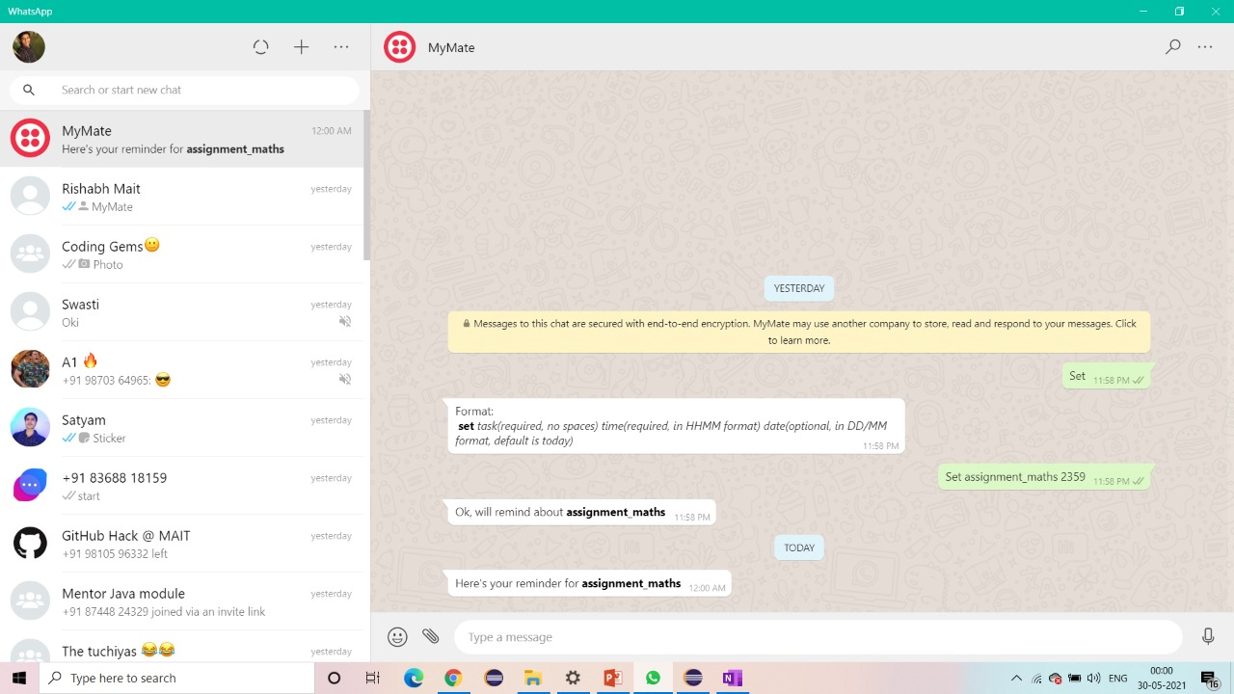

Slide 8
Features
Class alerts:
Deadline of college assignments.
It will give daily reminders for left submission.
Command : set class_<subject_name> <scheduled_time> <scheduled_date>
Sample command : set class_physicsII 0915 31/05
Output :
Ok, will remind about class_physicsII (Just after set query)
Here’s your reminder for class_physicsII (At 9.05AM)
Gives alerts till the 10 mins before scheduled meeting.

Slide 9
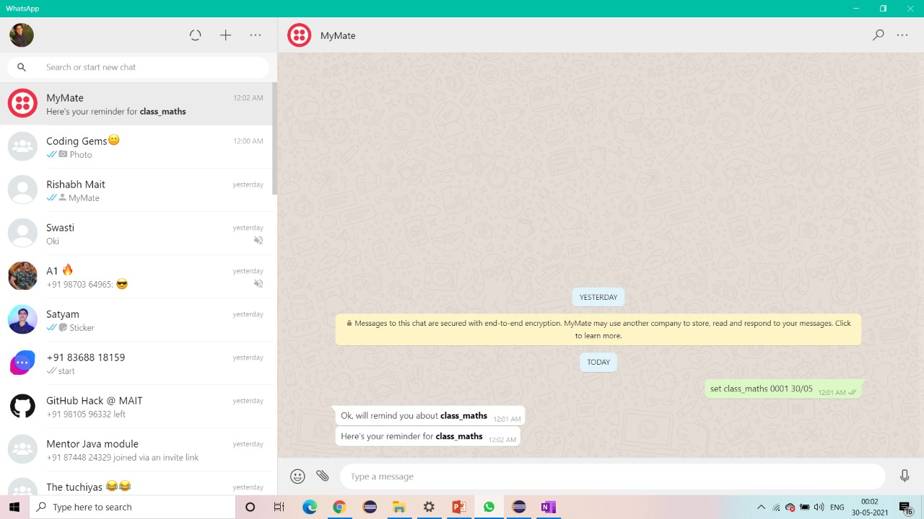

Slide 10
Features
Contest Reminder :
Competitive coding contest reminders and information.
Including contest on leetcode , codechef, code forces etc.
Command : set <site_name> <remind_time>
Sample commands :
set codechef_reminder 2100
set leetcode_reminder 2200
Output :
Ok, will remind about codechef_reminder (Just after set query)
Here’s your reminder for codechef_reminder (At 9PM)
Ok, will remind about leetcode_reminder (Just after set query)
Here’s your reminder for leetcode_reminder (At 10PM)

Slide 11
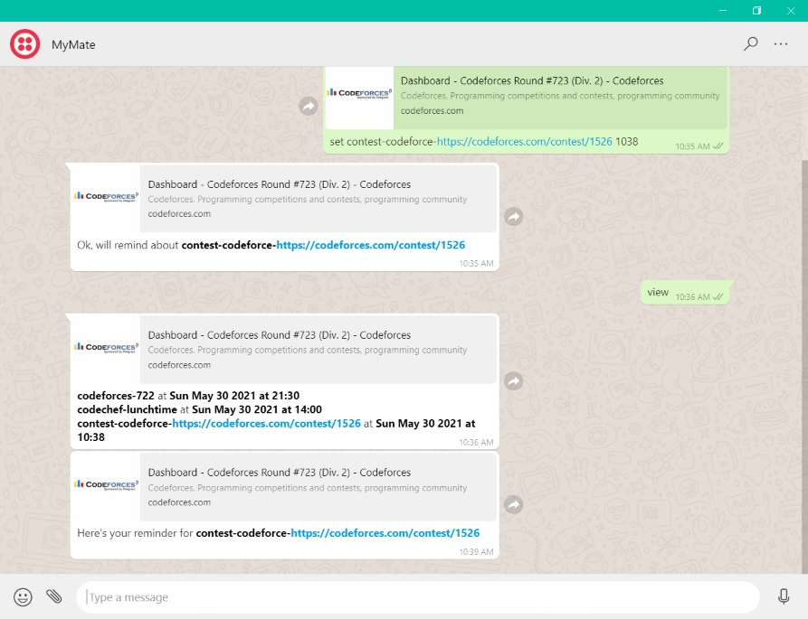

Slide 12
Features
View :
It will display the list of set reminders,
Command : view
Output :
physics_lecture at Mon May 31 2021 at 12:30
assignment_mathsII at Sun Jun 06 2021 at 13:00

Slide 13
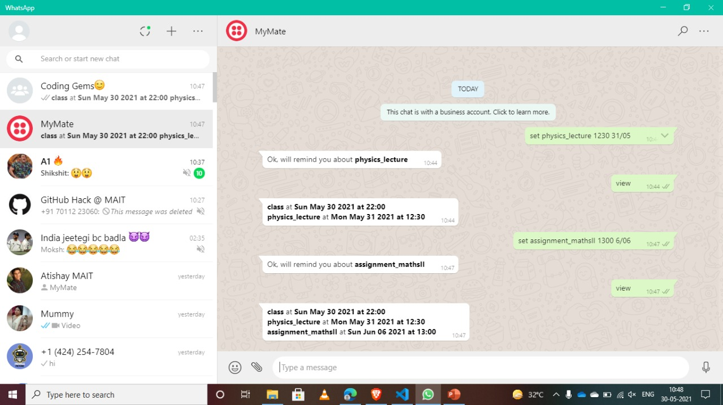

Slide 14
Thank You
Chirag Goel
Atishay Jain
Rishabh Gupta

